Slide 1
Capstone-1
Superstore Sales Analysis
kajal yadav

Slide 2
objective
Objective of this project is to analyse the data and extract meaningful insights from it.
This superstore sales data consists information about the PRODUCT, ORDER and CUSTOMER.
Dataset contains these columns : OrderID, OrderDate, ShipDate, CustomerID, CustomerName, Category, ProductName, Sales, Profit etc.
Technology used in this project is MYSQL for Data Analysis and PowerBI for Dashboard Respresentation.

Slide 3

Power BI is one of the most popular Data Visualization and Business Intelligence tool. The Power BI tool is the collection of apps, data connectors, and software services which are used to get the data from different data sources, transforms data, and produces useful reports.

Slide 4
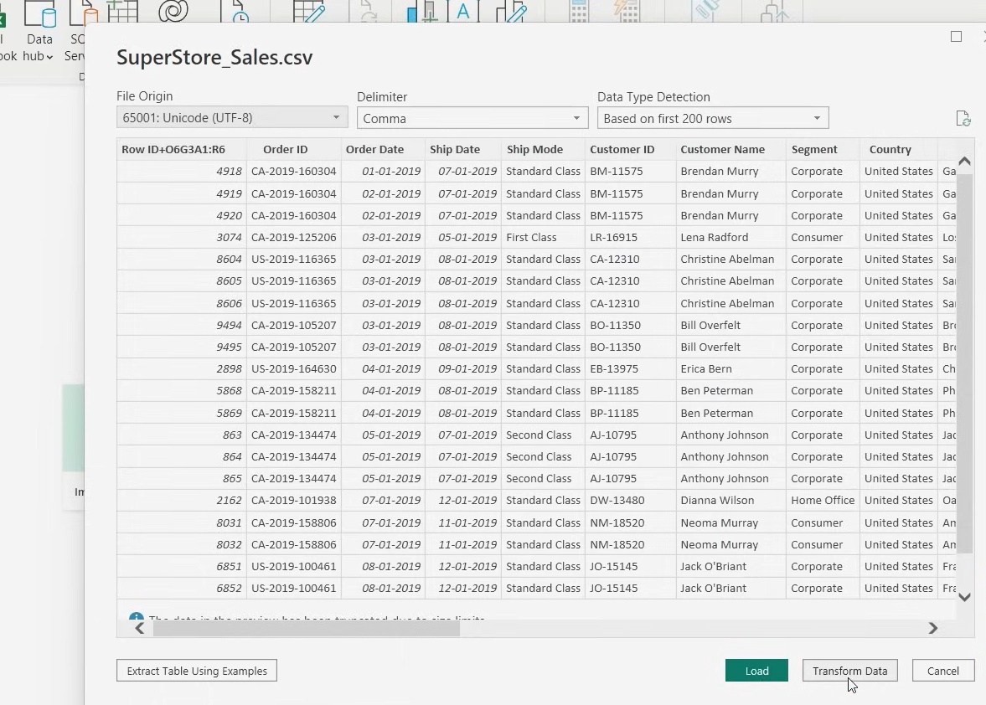
Step 1: dataset loading

Slide 5
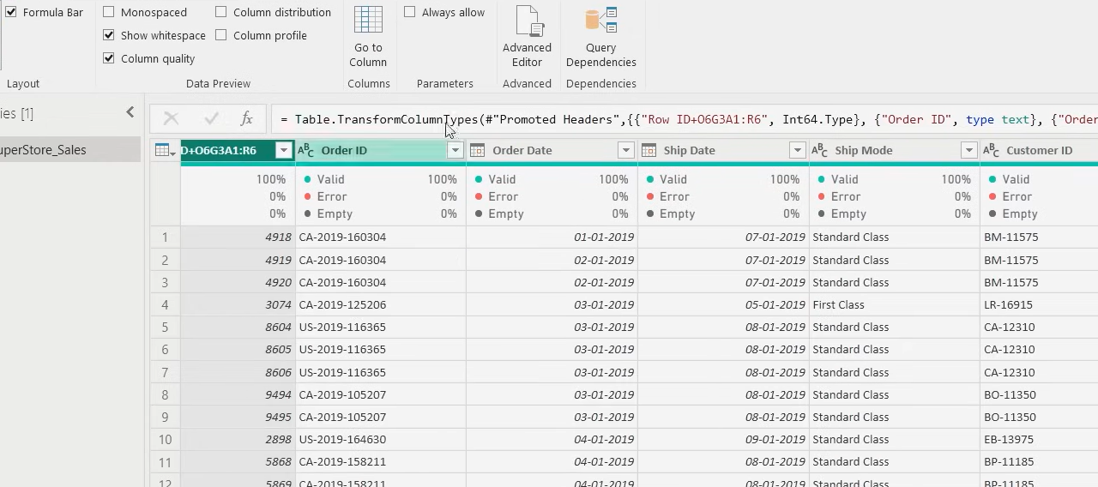
Step 2: DATA cleaning
1. Checking Nulls

Slide 6
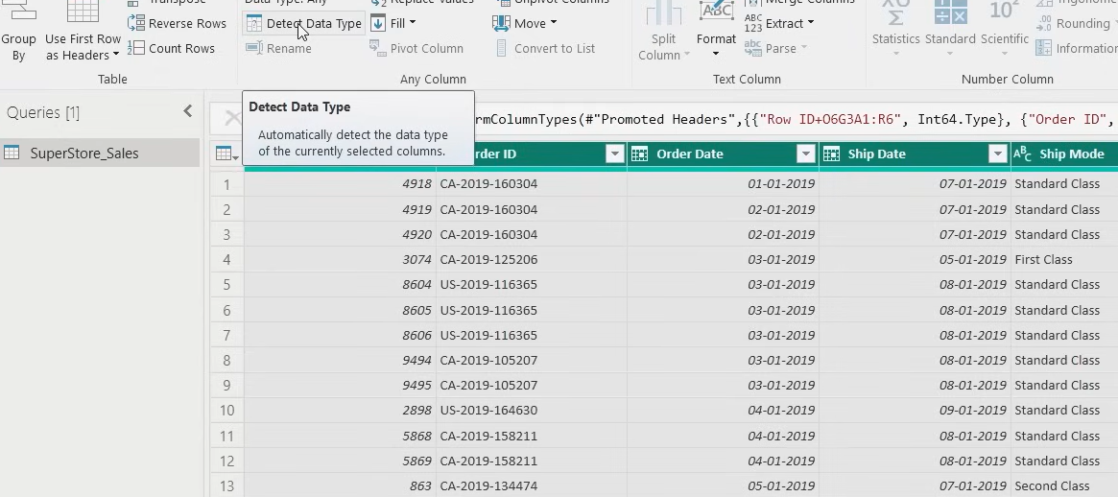
2. Detecting Data Type

Slide 7
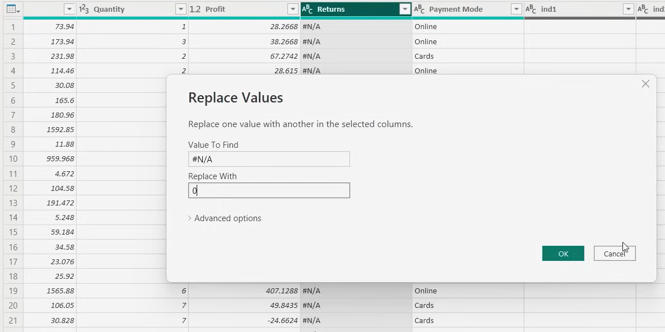
3. Replacing Error values

Slide 8
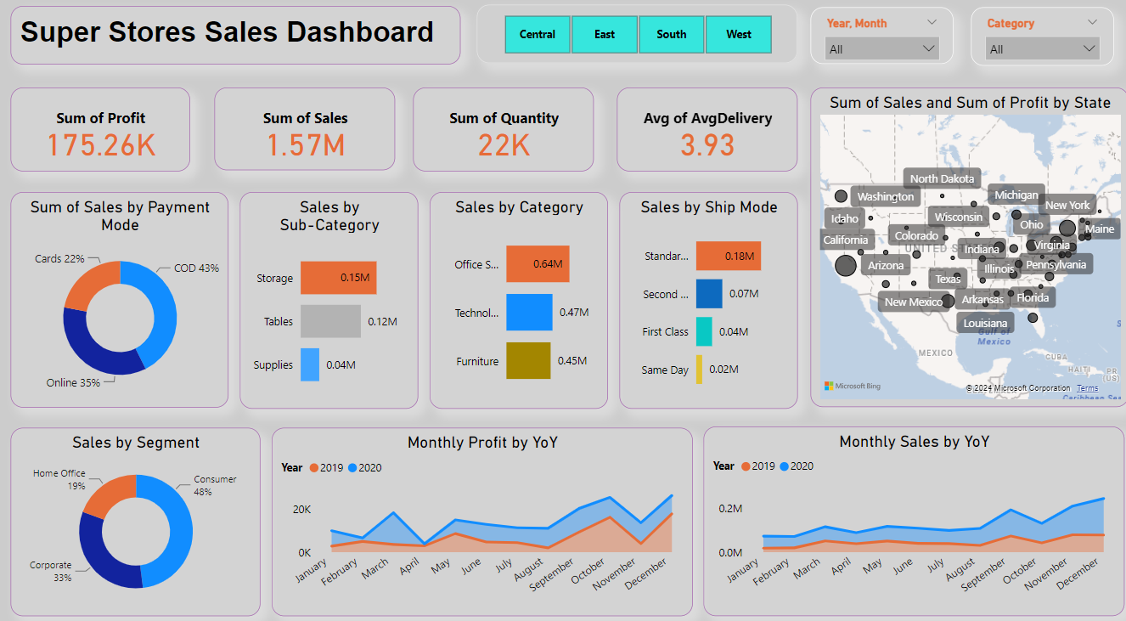
Dashboard

Slide 9
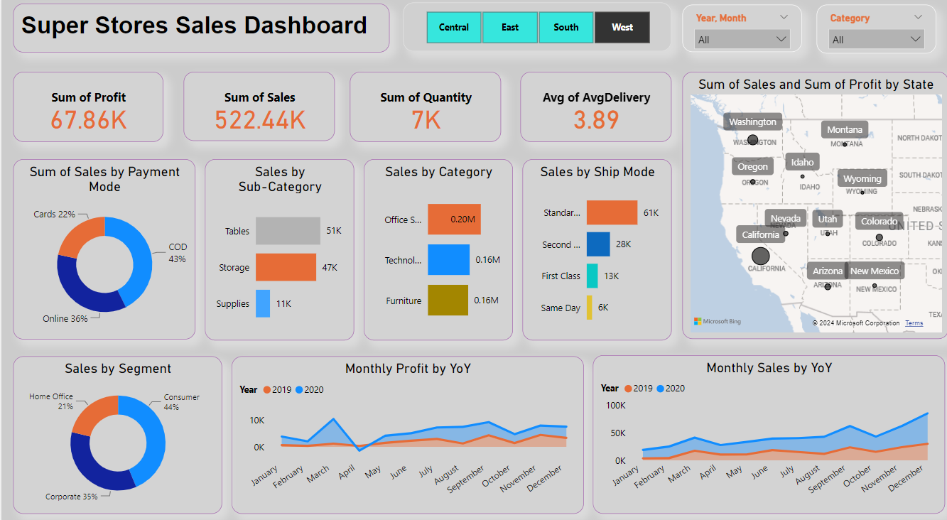
Dashboard Screenshot 1
Here we compared direction wise sales and found that ‘West’ direction has highest number of sales

Slide 10
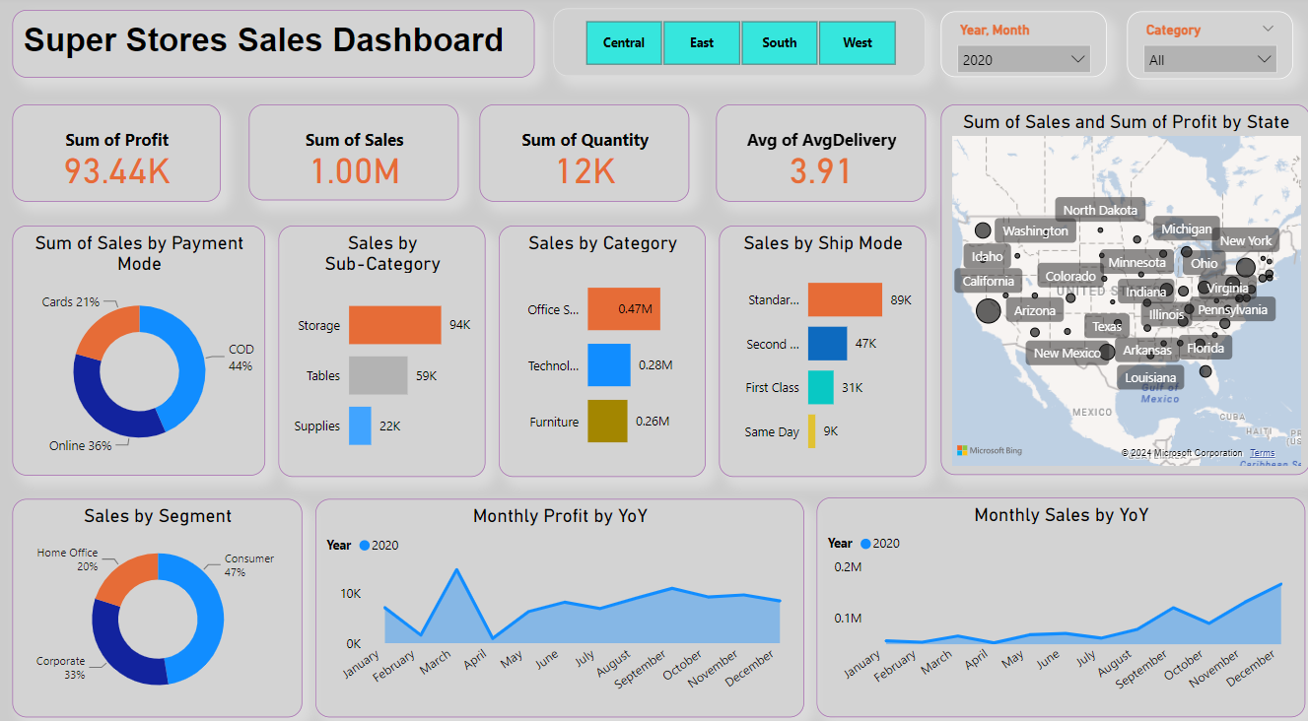
Dashboard Screenshot 2
Here we filtered Dashboard year wise and found highest sales and profit in year 2020

Slide 11

MySQL is a very popular open-source relational database management system (RDBMS). MySQL is a open source and free RDBMS.

Slide 12


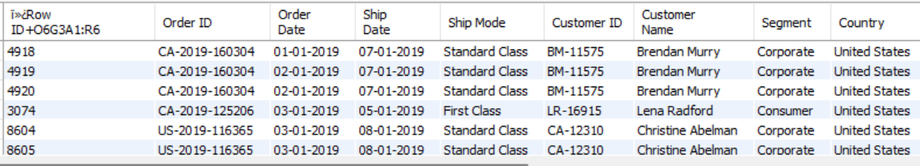

Slide 13
Queries for data analysis
These Queries consists some deep insights about the sales data and what is the progress of the company

Slide 14
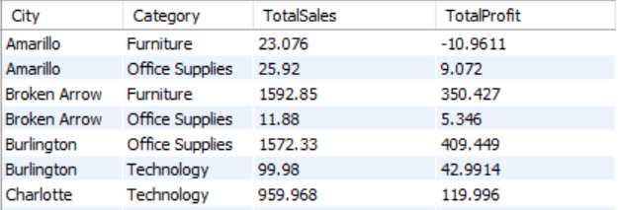
Query 1: City and Category wise total Sales and Profit

Slide 15
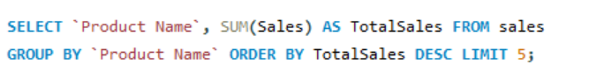
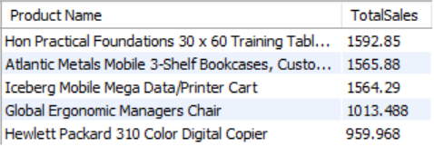
Query 2: Top 5 Products by Sales

Slide 16
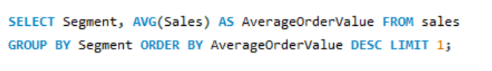
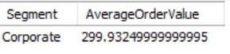
Query 3: Customer Segment with the Highest Average Order Value

Slide 17
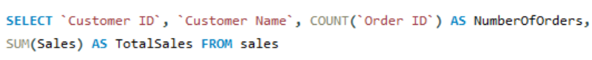
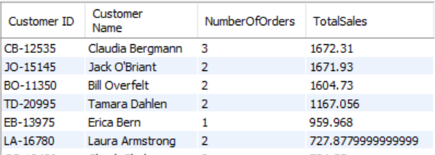
Query 4: Number of Orders and Total Sales for each Customer

Slide 18
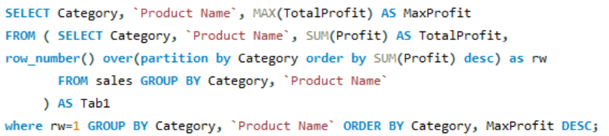
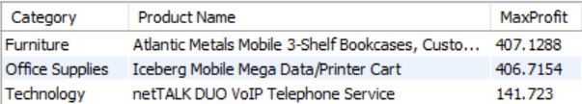
Query 5: Most Profitable Product in each Category

Slide 19
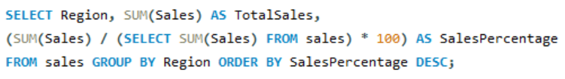
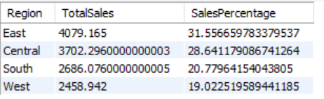
Query 6: Percentage Contribution of Each Region to Total Sales

Slide 20
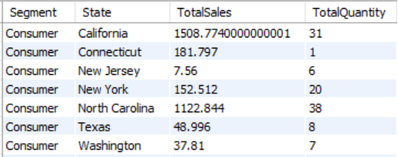
Query 7: Total Sales and Quantity by Customer Segment and State

Slide 21
summary
Total sales of Products increased year by year
Total profit of company increased year by year
Most of the customers prefer COD Delivery option over others.
In state Amarillo product category furniture and in state Cleveland product category Technology is in loss, we should try invest more time and research on this product make them profitable.
In segment corporate we found that highest order value.
Most of the Customers placed 2 to 3 orders which is low, we should try to keep our customers visit and order regularly using introducing gifts for regular customers and encourage them to buy products repeatedly.
There are top most profitable products by category
In Furniture - Atlantic Metals Mobile shelf.
Office Supplies - Iceberg Mobile Mega Data/Printer Cart
Technology – net TALK DUO VoIP Telephone Service
We noticed highest sales in year 2020.
These insights can help to grow business and plan accordingly in which area we need to invest more time and money.
We can prepare our plans and strategies accordingly.

Slide 22
Thank You

